Slide 1

Museum as Brave Space
FRAME Annual Conference Round Table
October 31, 2019
Olivier Meslay, Hardymon Director
Sterling and Francine Clark Art Institute

Slide 2
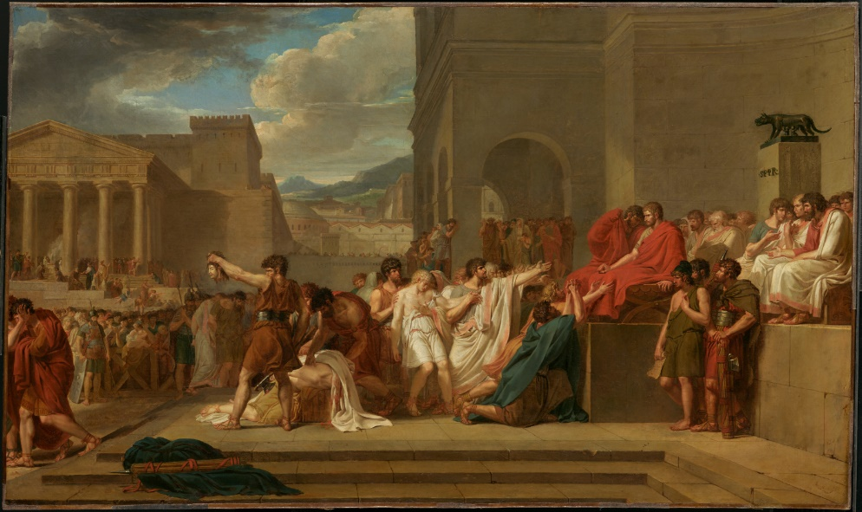
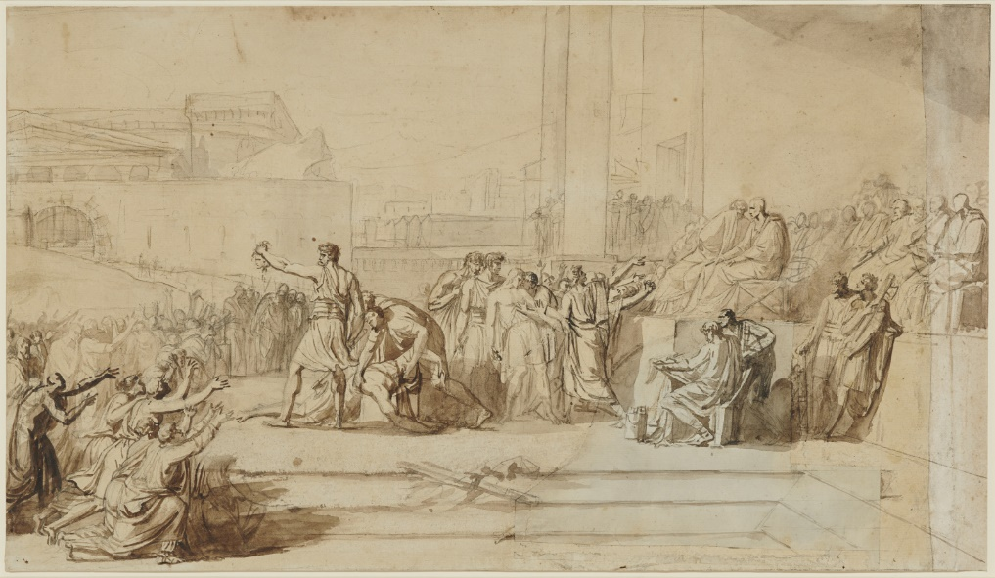
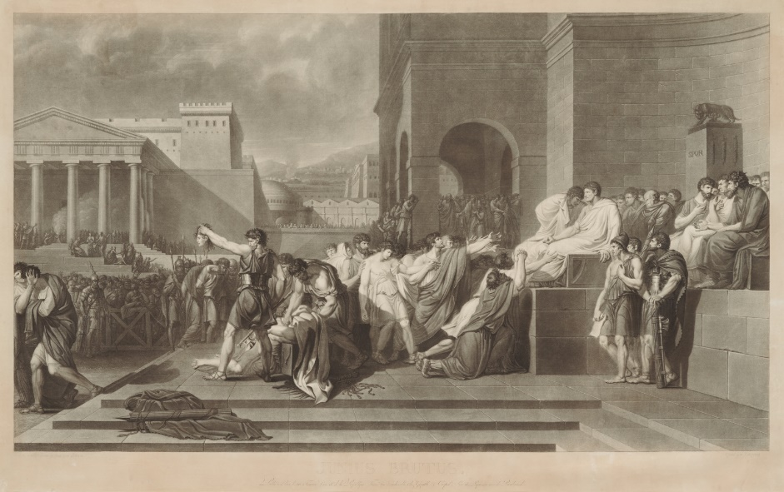
Recent Acquisitions
Guillaume Lethiére (1760-1832)
Brutus Condemning His Sons to Death, 1788
oil on canvas, 59.4 x 99.1 cm.
Acquired by the Clark, 2018
Guillaume Lethiére (1760-1832)
Brutus Condemning His Sons to Death, 1788
chalk with wash, 35.6 x 62.2 cm.
Acquired by the Clark, 2018
Pierre Charles Coqueret (1761-1832),
After Guillaume Lethiére
Brutus Condemning His Sons to Death, 1794
engraving, 22 1/2 x 38 3/4 cm.
Acquired by the Clark, 2018

Slide 3
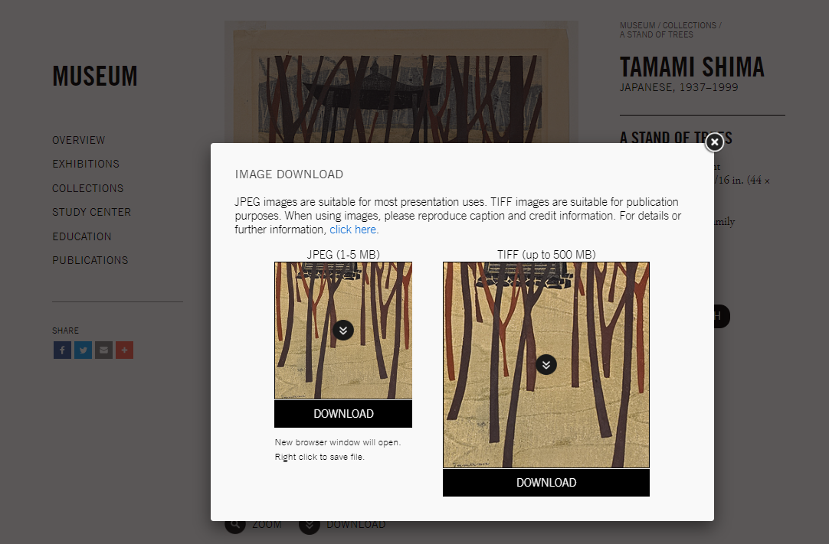
Open Access Images

Slide 4
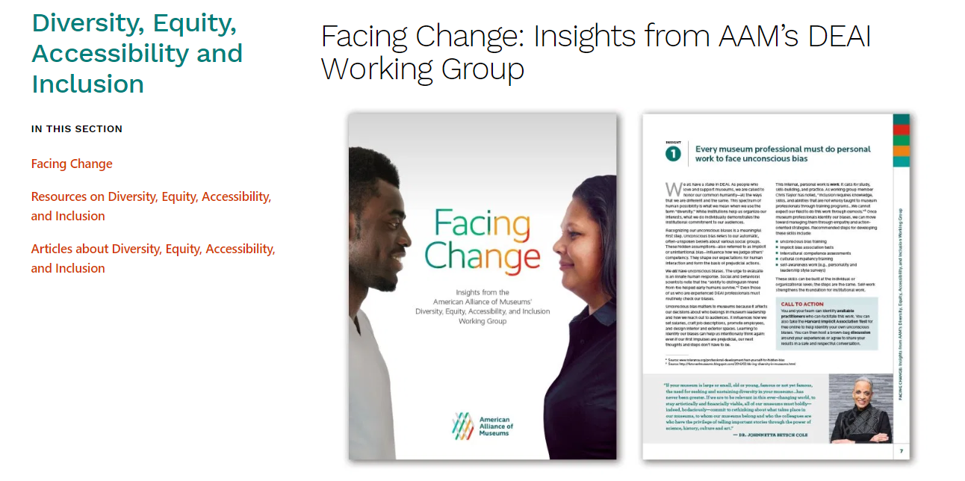
Diversity, Equity, Accessibility, Inclusion (DEAI)
American Alliance of Museums, 2018

Slide 5
International Council of Museums (ICOM)
“Museums are democratizing, inclusive and polyphonic spaces for critical dialogue about the pasts and the futures. Acknowledging and addressing the conflicts and challenges of the present, they hold artifacts and specimens in trust for society, safeguard diverse memories for future generations and guarantee equal rights and equal access to heritage for all people.
Museums are not for profit. They are participatory and transparent, and work in active partnership with and for diverse communities to collect, preserve, research, interpret, exhibit, and enhance understandings of the world, aiming to contribute to human dignity and social justice, global equality and planetary wellbeing.”
- Jette Sandahl, 2019

Slide 6
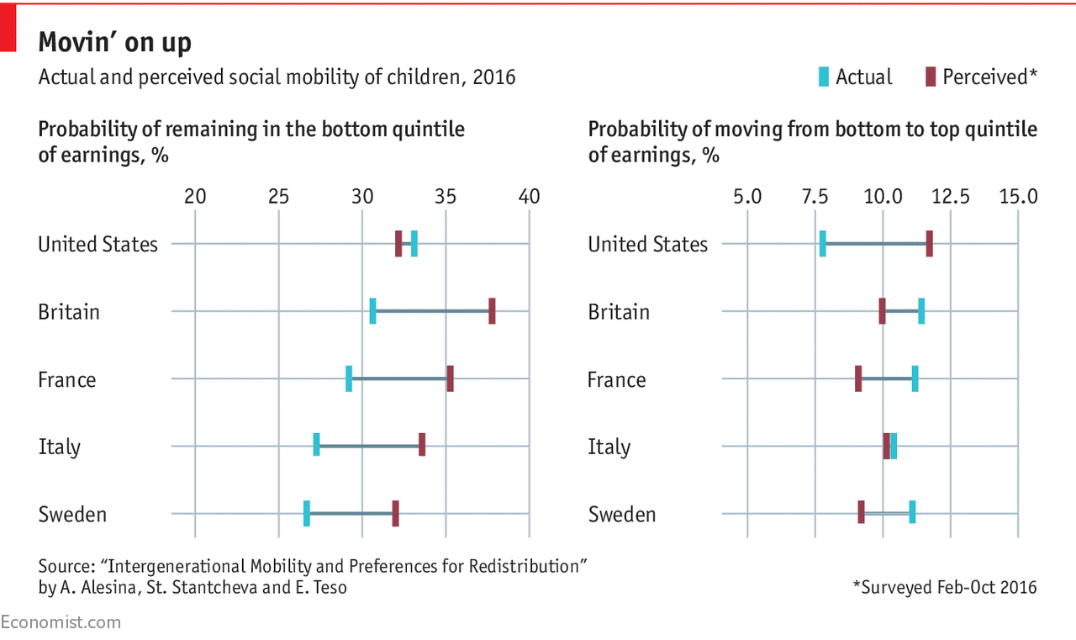
Social Mobility

Slide 7
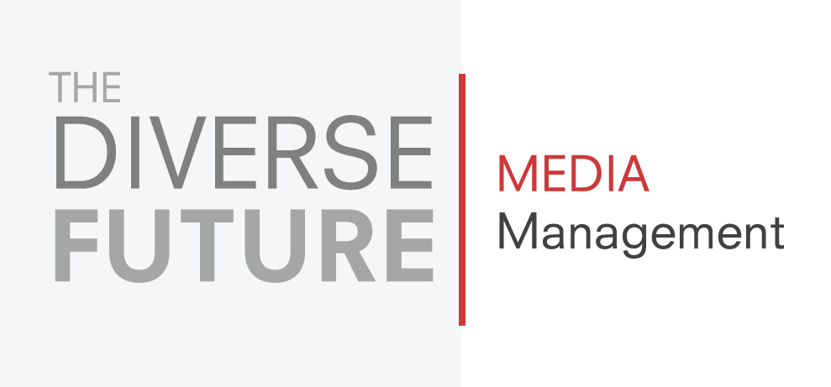
The Diverse Future

Slide 8
Clark 2020 Exhibition Program
Claude and François-Xavier Lalanne: Nature Transformed
May 9, 2020 – November 1, 2020
Nikolai Astrup: Visions of Norway
June 13, 2020 – September 7, 2020
Lin May Saeed: Arrival of the Animals
June 22, 2020 – October 12, 2020
Ground/work
June 27, 2020 – Late Spring 2021
Pia Camil
Winter 2020 – 2021

Slide 9
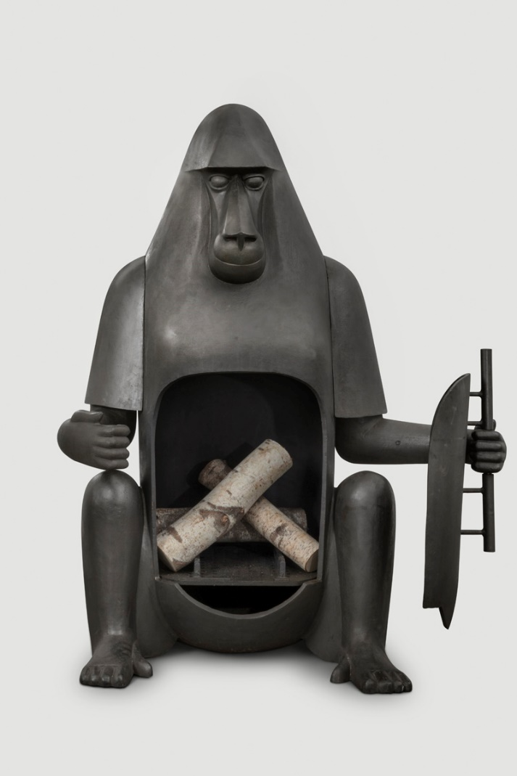
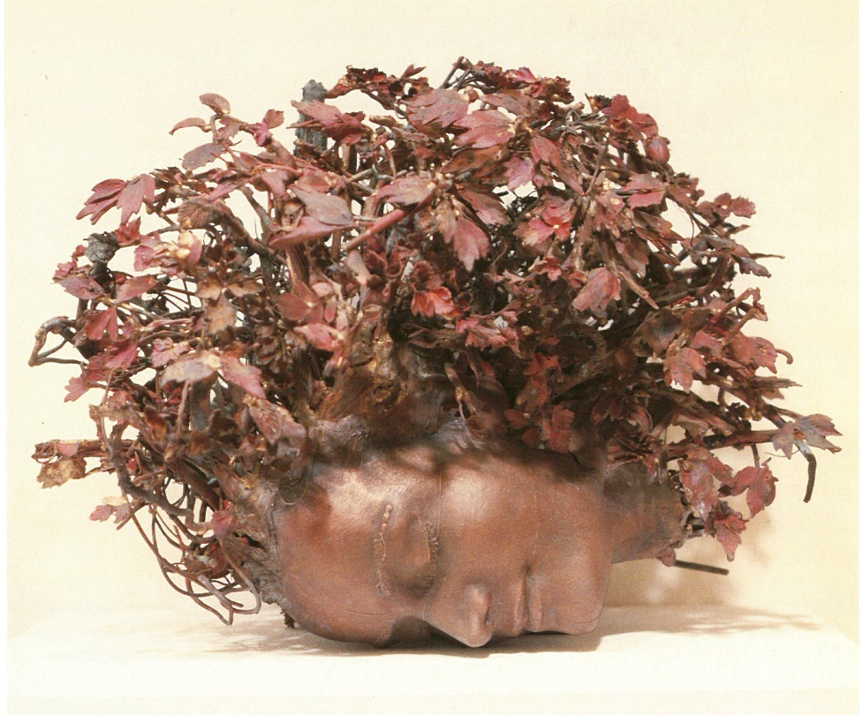
Claude and François-Xavier Lalanne: Nature Transformed
May 9, 2020 – November 1, 2020

Slide 10
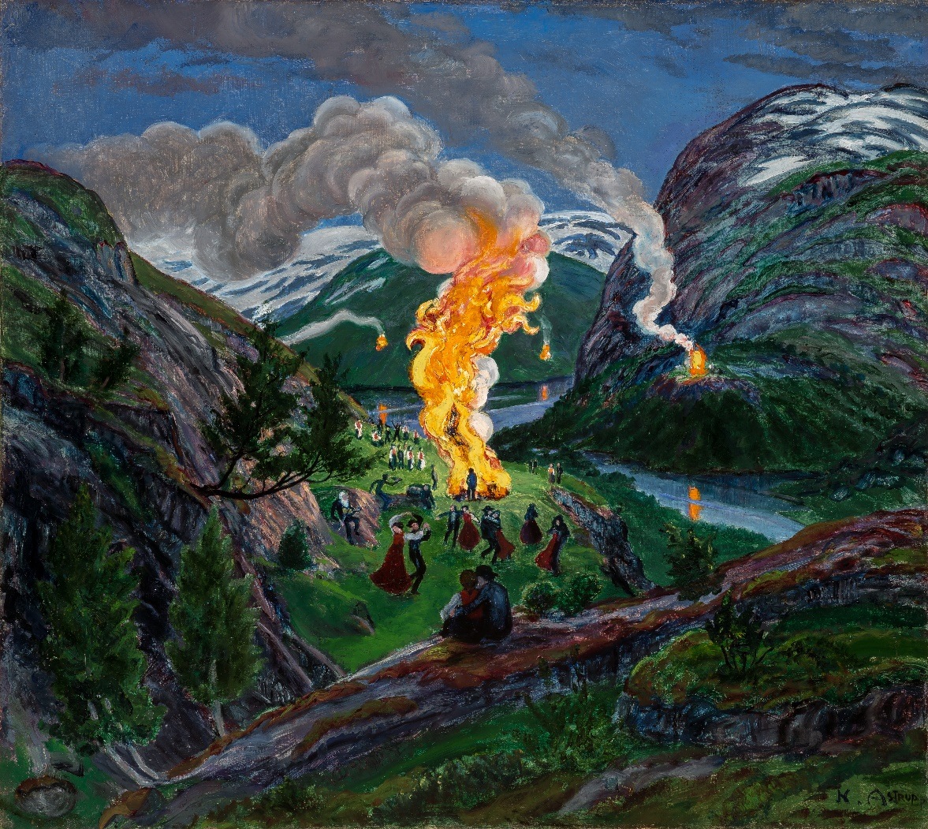
Nikolai Astrup: Visions of Norway
June 13, 2020 – September 7, 2020

Slide 11
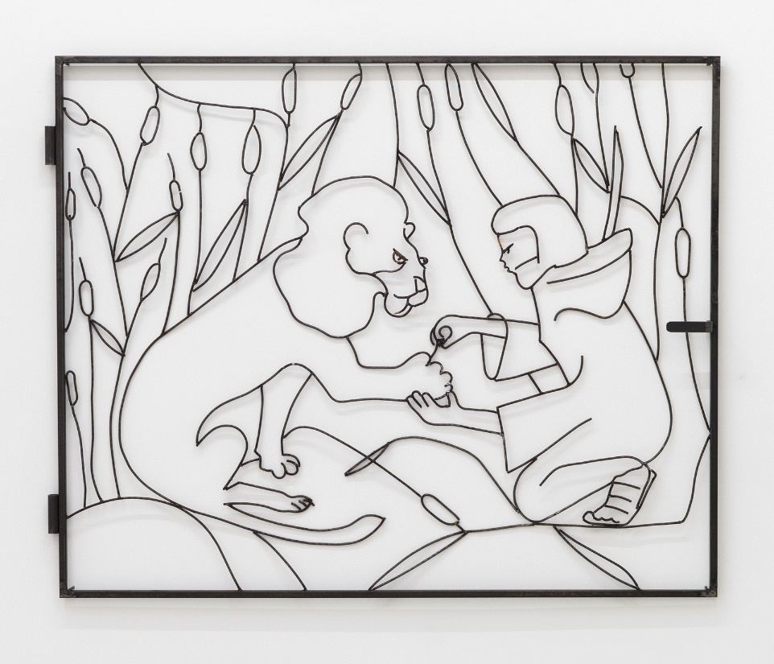
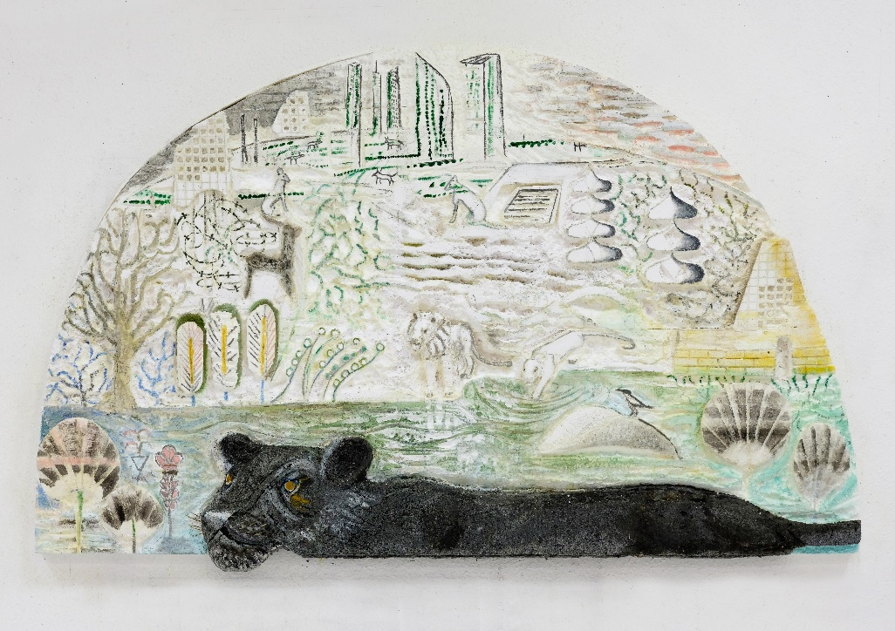
Lin May Saeed: Arrival of the Animals
June 22, 2020 – October 12, 2020

Slide 12
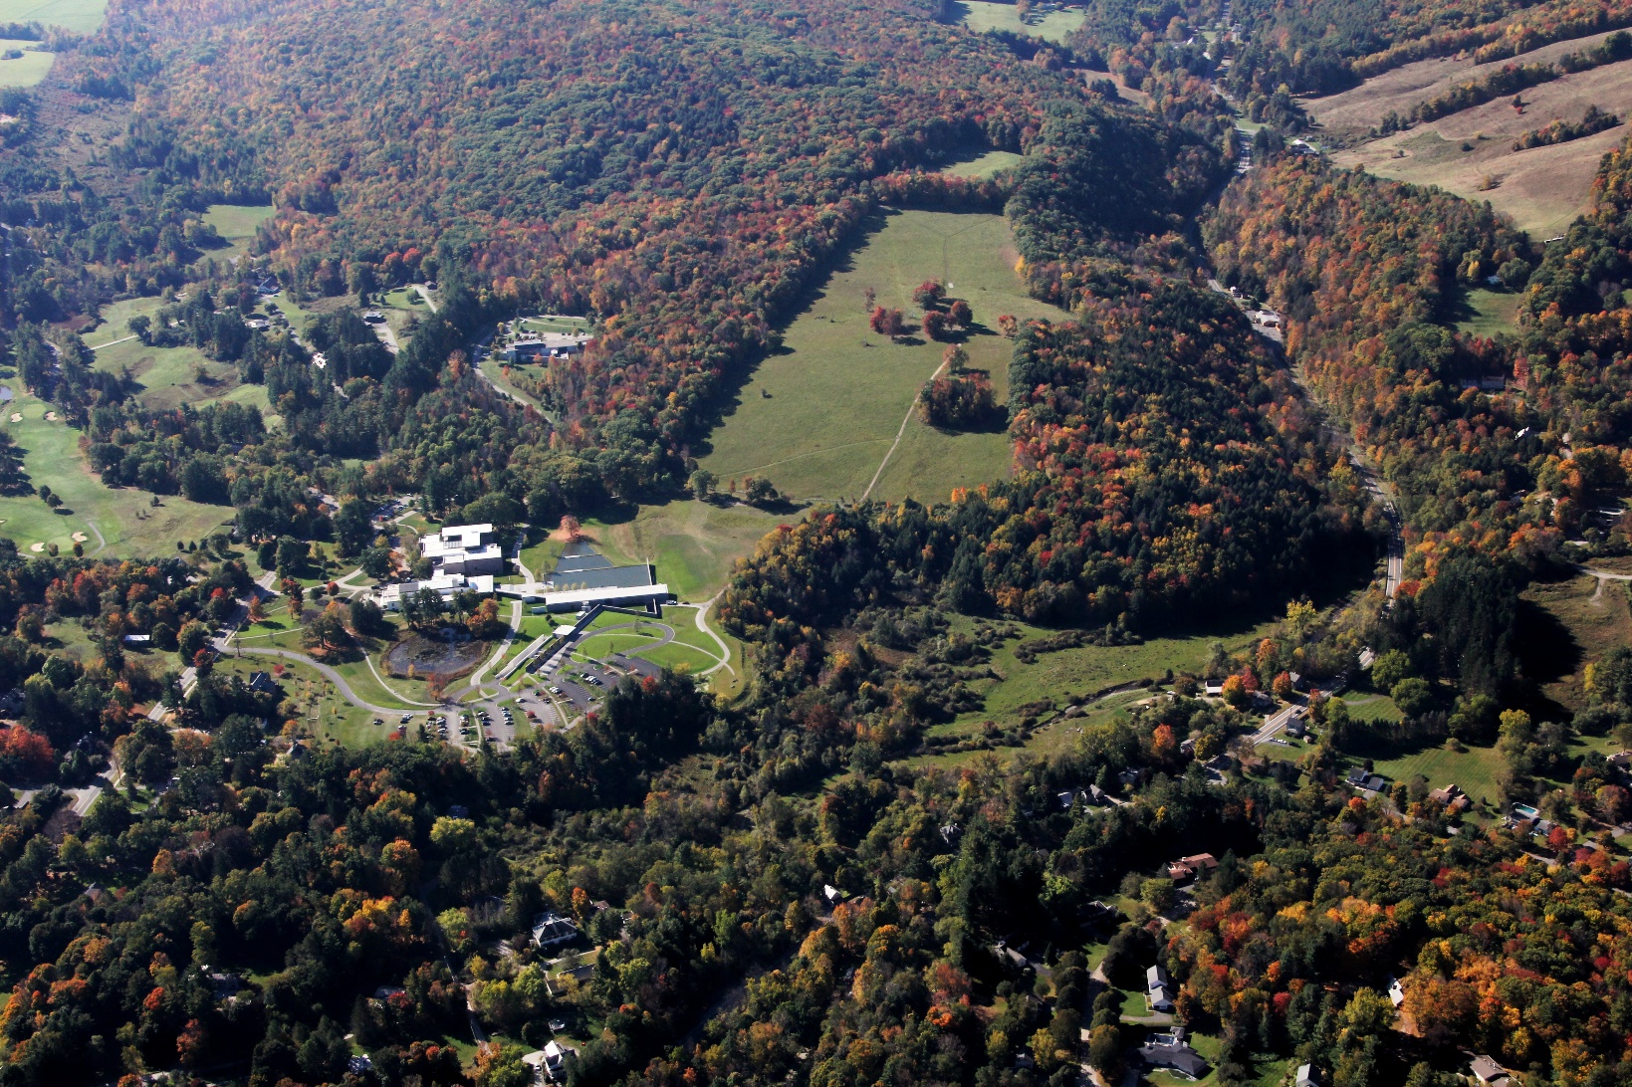
Ground/work
June 27, 2020 – Late Spring 2021

Slide 13
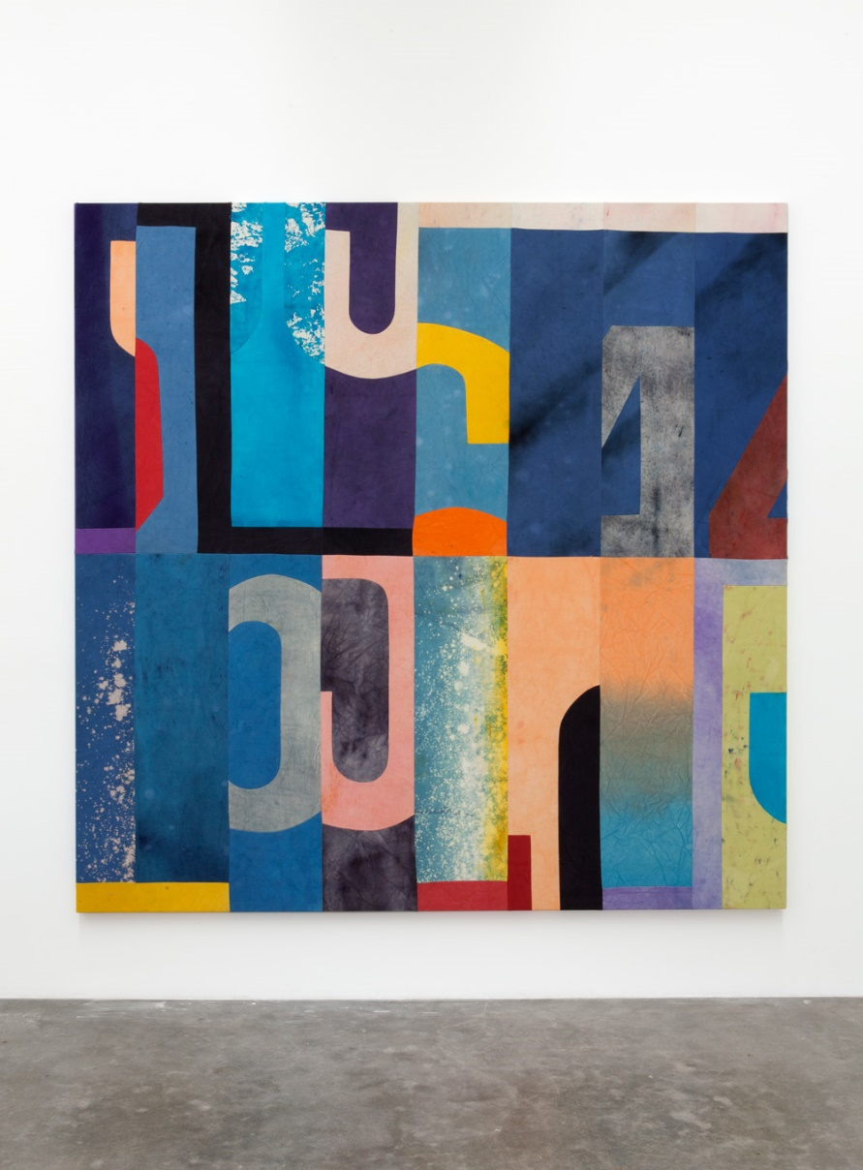
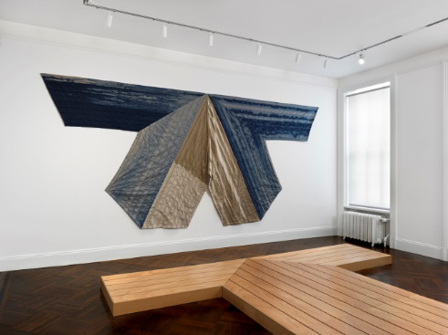
Pia Camil
Winter 2020 – 2021

